Slide 1
Cancer
Lesson 3.2 - Part 1
How do normal cells become cancer cells?

Slide 2
Do Now
What are these steps in the life cycle of a cell?
A new cell is born
It talks to its friends
It grows up and gets a job
It gets old and dies

Slide 3
The steps in a cell’s life cycle
A new cell is born
It talks to its friends
It grows up and gets a job
It gets old and dies
Cell division
Cell signaling
Cell differentiation
Cell aging and death

Slide 4
What happens when the cell becomes cancerous?
A new cell is born
It talks to its friends
It grows up and gets a job
It gets old and dies
Cell division
Cell signaling
Loses control
Cell differentiation
Cell aging and death
This is called Transformation!
Notes:
Tell the students the process of loss of control is called transformation. The next two lessons are about how transformation occurs

Slide 5
How do normal cells transform into cancer cells?
A new cell is born
It talks to its friends
It grows up and gets a job
It gets old and dies
Cell division
Cell signaling
Lose control
Cell differentiation
Cell aging and death
Mutations!
Notes:
Narrative mutations cause loss of control. What are mutations

Slide 6
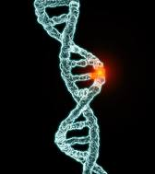
Mutations are permanent changes in DNA sequence
Notes:
Answers the question

Slide 7
Driving cells towards cancer
Mutations that switch oncogenes ON
Mutations that switch tumor suppressor genes OFF
Oncogenes are like the gas
Tumor suppressors are like brakes
Notes:
We have talked before about how proto-oncogenes are switched on and tumor suppressors are switched off in cancer (review these concepts – proto-oncogenes make the cell divide, tumor suppressors regulate when the cell divides, how can mutations affect these genes?

Slide 8
How mutations can switch genes on and off
Gene Expression
Transposons with active promoters switch gene transcription on permanently
Proto-Oncogene
Transposon
Transposons insert into an exon and switch gene transcription off permanently.
Transposon
Gene
Notes:
Uses the slide from the previous lesson to give an example of how a gene can be switched on and off. Emphasize that in this example, the permanent change in DNA sequence caused by the transposon (i.e. the mutation) is controlling gene transcription itself). Not necessary at this point to go into more detail.

Slide 9
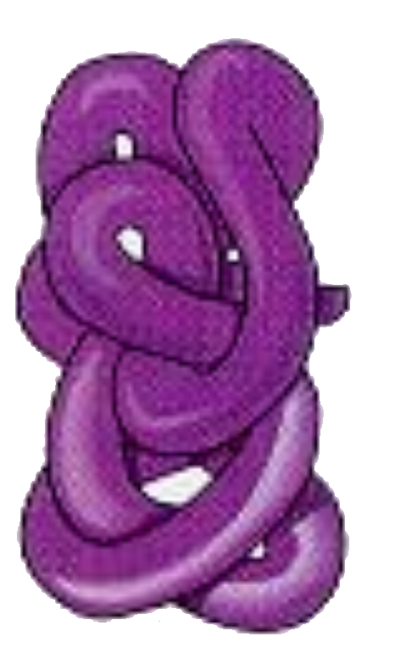
Mutations can also affect how a gene is translated
Normal
DNA
Protein
Transcription
Translation
Active!
RNA
Mutated
DNA
Mutated
Protein
Transcription
Translation
Inactive!
Notes:
This introduces the idea that the gene makes protein and that if the DNA is damaged then the protein may also be damaged and inactive.

Slide 10
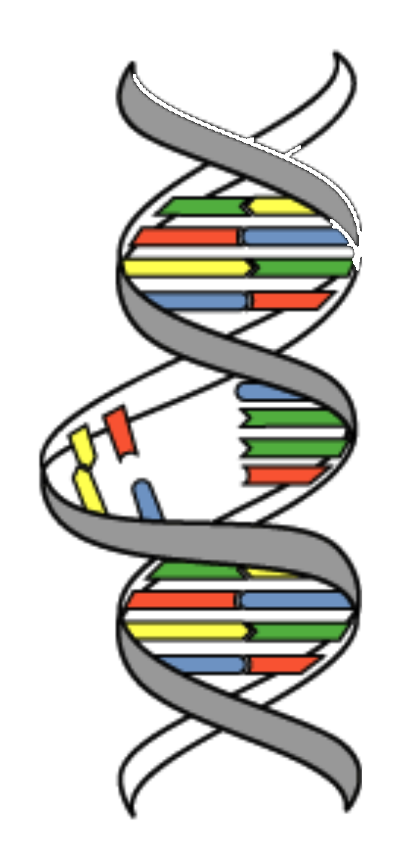
Mutations occur every time a cell replicates its DNA
Notes:
This takes a step back and asks how does DNA get damaged. Very important slide because it emphasizes that DNA damage is a normal result of replication. Put in numbers about error rate.

Slide 11
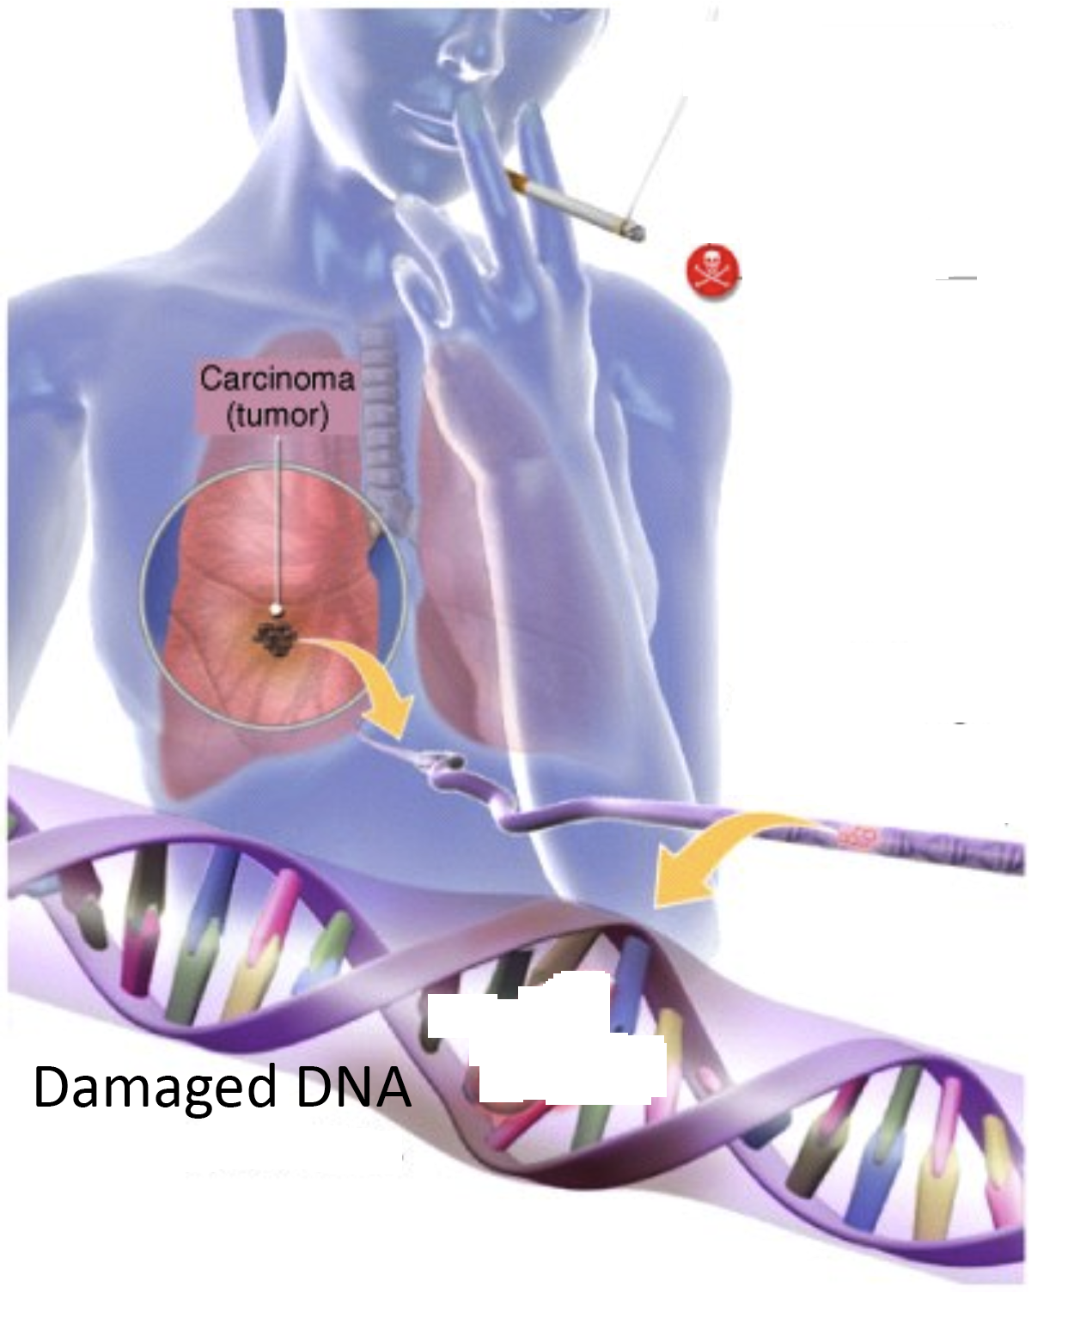
Carcinogens increase DNA mutation rate
Notes:
Carcinogens increase the mutation rate

Slide 12
What do mutations affect?
Large segments of chromosomes
Individual nucleotides
Notes:
Starts to talk about what mutations can affect, now we’ll go through both, step by step.

Slide 13
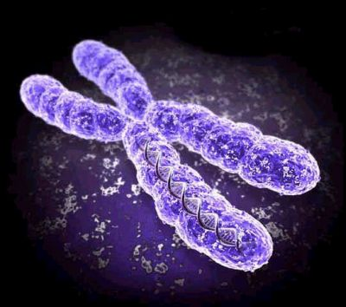
Replicating chromosomes are unstable
Notes:
Chromosomes can break when they are replicating normally and when they are repaired incorrect repair can occur.
Carcinogens like UV sunlight can also cause chromosome instability by causing the chromosomes to break. The more they break the more likely that repair will be abnormal.

Slide 14
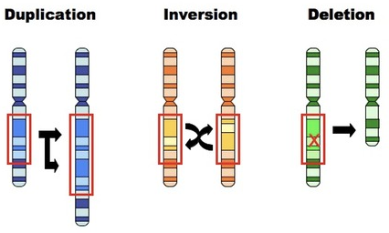
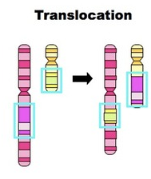
What happens to unstable chromosomes?
Notes:
Changed this slide
Duplications - a part of the chromosome is copied, resulting in duplicate segments (potentially increasing gene expression)
Inversions - a segment of a chromosome is removed and then replaced in reverse order
Deletions - a portion of a chromosome is lost (along with any genes contained within this segment)
Insertions - a part of one chromosome is removed and added to another chromosome (may interrupt gene sequences)
Translocations - segments of two chromosomes are exchanged (may interrupt gene sequences)
Ask students to predict, whether these changes would alter gene expression (more or less).

Slide 15
When a chromosome is unstable
B
B
B
Notes:
This shows an actual picture of a translocated chromosome. Translocations are not uncommon and won’t have an effect if genes are moved from one place to another unless:
They are broken
They are duplicated
They are separated from their regulatory elements.

Slide 16
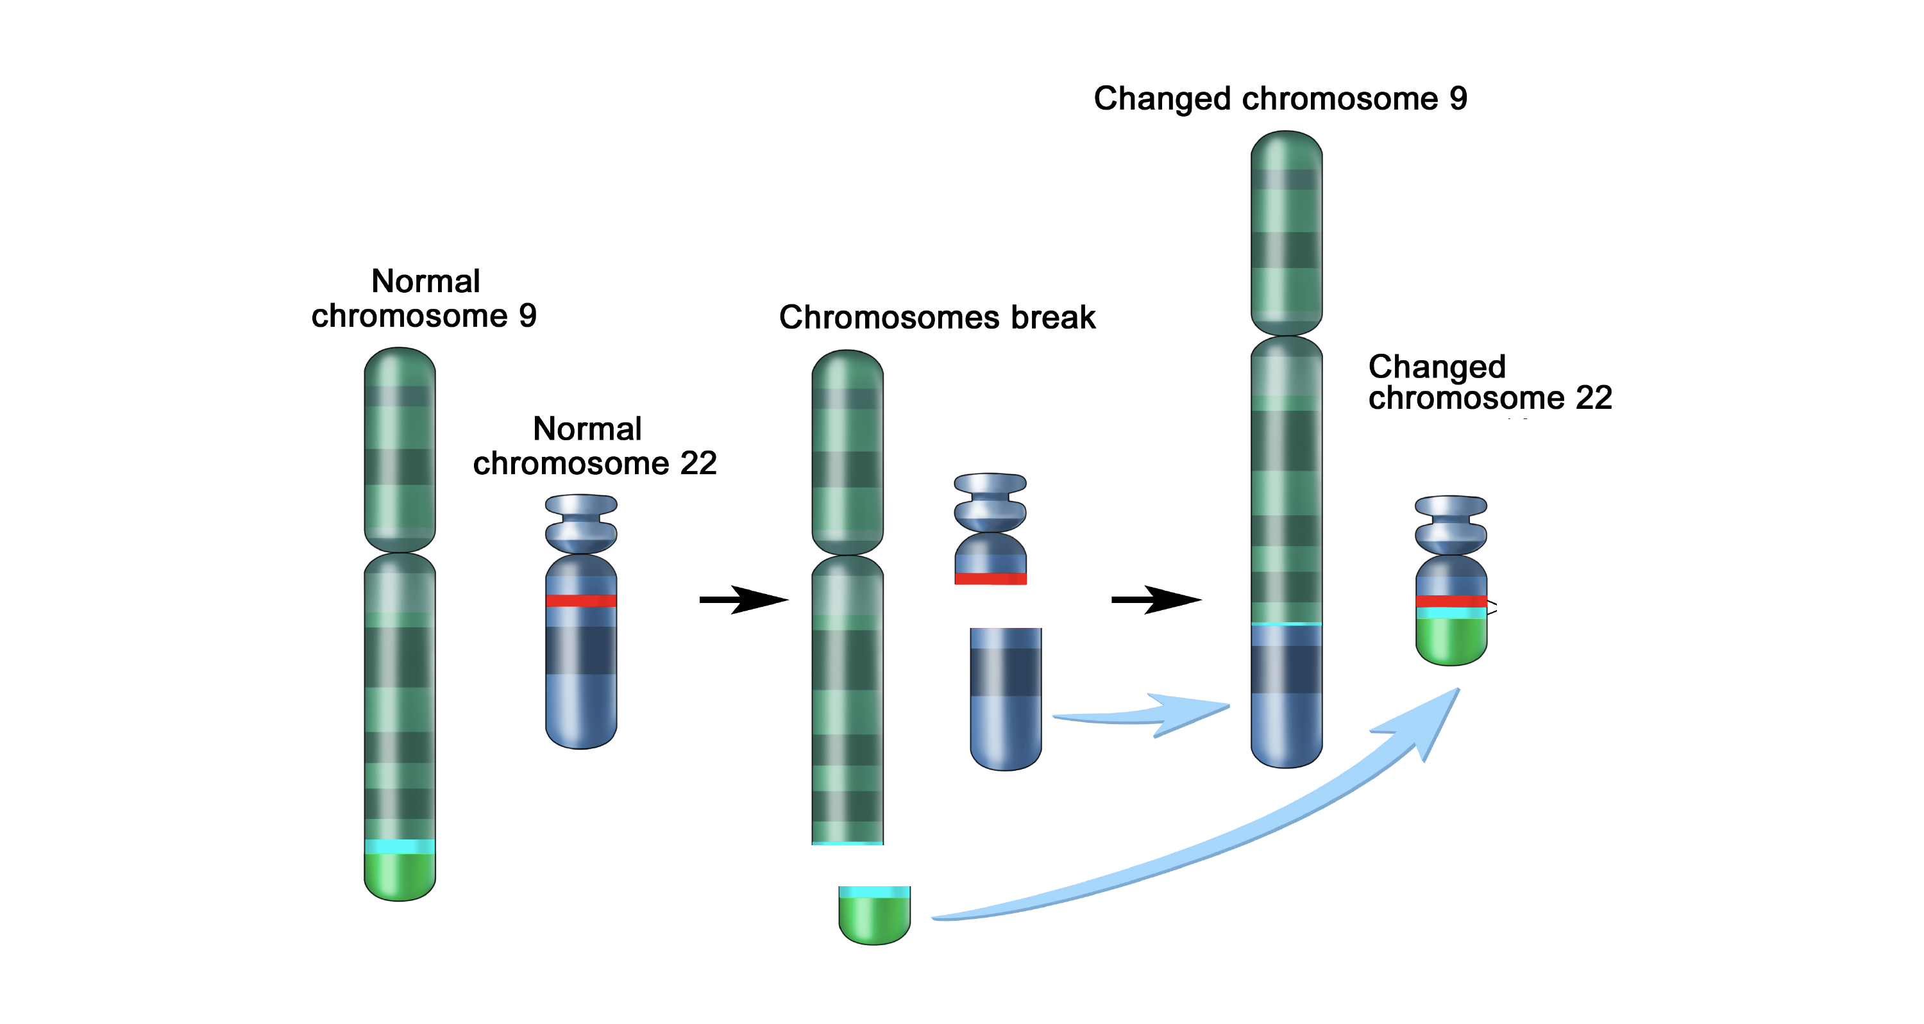
Translocation mutations are common in leukemias
B
B
B
Translocation!
ABL gene
Notes:
Important to show an actual example (some info about Burkitt’s lymphoma).

Slide 17
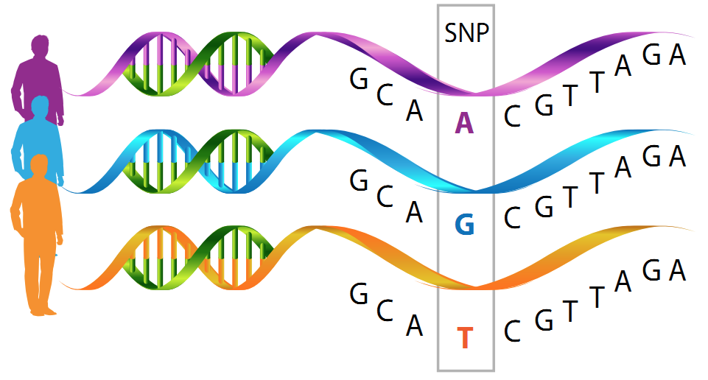
Mutations in single bases - SNPs*
* SINGLE NUCLEOTIDE POLYMORPHISMS
Notes:
Second point – mutations in single bases. SNPs occur naturally in the population. They can be:
In genes (exons and introns)
In regulatory sequences
In untranslated regions with no function
Only important if they’re present in genes or in regulatory sequences (untranslated regions act as buffers)

Slide 18
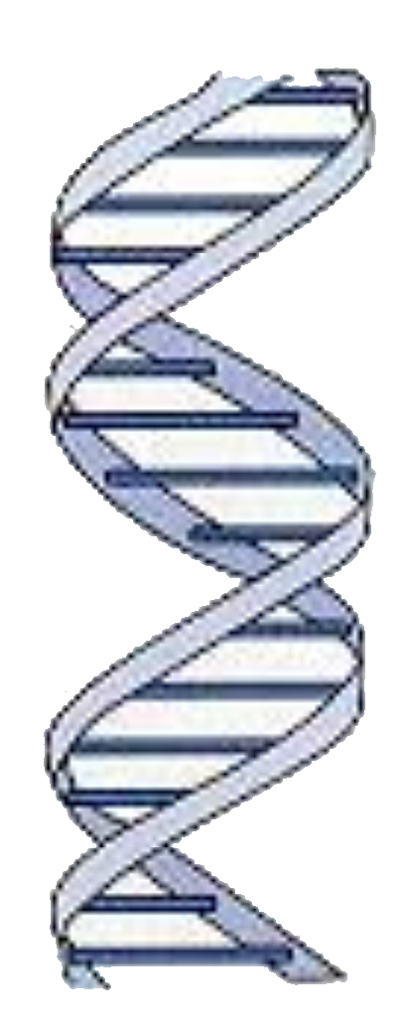
Making proteins from DNA
DNA
Protein
3 bases
1 amino acid
AGC
serine
codon
Notes:
This starts to link DNA to proteins. Talks about how DNA makes proteins and also brings up how protein shape is important and that mutations could affect protein shape.

Slide 19
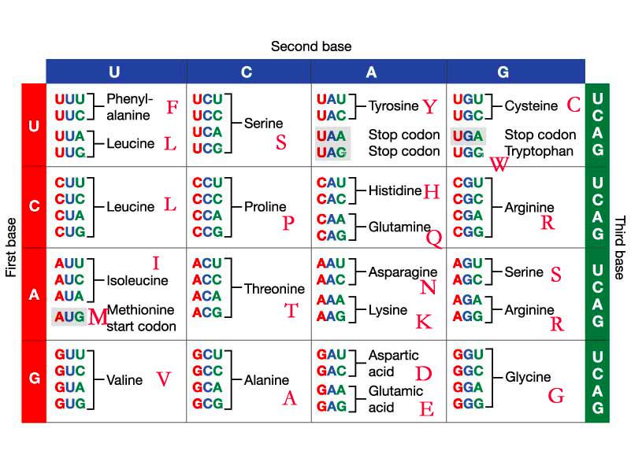
Amino acid codons
Notes:
Working with codons

Slide 20
Divide this ‘DNA sequence’ into codons
THEBIGBADFLYHADONEREDEYEANDONEBLUEYE
THE BIG BAD FLY HAD ONE RED EYE AND ONE BLU EYE
Notes:
Working with codons

Slide 21
Activity
How single nucleotide (point) mutations affect protein function
Notes:
The first part of the activity just talks about different point mutations, the second part about codons

Slide 22
Wrap up: making point mutations
THE BIG BAD FLY HAD ONE RED EYE AND ONE BLU EYE
Take the Y out of ‘Fly’ and rearrange the codons
THE BIG BAD FLH ADO NER EDE YEA NDO NEB LU EYE
This is called a deletion mutation
Notes:
Wrap up from the activity

Slide 23
Wrap – up: making point mutations
THE BIG BAD FLY HAD ONE RED EYE AND ONE BLU EYE
Add an extra Y after ‘Fly’ and rearrange the codons
THE BIG BAD FLY YHA DON ERE DEY EAN DON EBL UEY E
This is called an insertion mutation
Notes:
Both deletion and insertion mutations can cause protein translation to terminate

Slide 24
Wrap-up: making point mutations
THE BIG BAD FLY HAD ONE RED EYE AND ONE BLU EYE
Change the D in ‘Had’ for S and rearrange the codons
THE BIG BAD FLY HAS ONE RED EYE AND ONE BLU EYE
This is called a substitution mutation
Notes:
Now we start to talk about codon usage. Will this change the protein structure – maybe not it is still a word

Slide 25
Wrap–up making point mutations
THE BIG BAD FLY HAS ONE RED EYE AND ONE BLU EYE
Amino acids can have more than one codon
Serine: AGC
AGU
UCG
UCA
UCU
UCC
Notes:
Has is a word like Had, it does not change the sense of the sentence, the protein can still be transcribed. Hence not all point mutations affect protein function

Slide 26
Substituion mutations
Serine: UCU
UCA
UCC
UCG
CCU, CCA, CCC, CCG = proline
ACU, ACA, ACC, ACG = threonine
GCU, GCA, GCC, GCG = alanine
Notes:
Has is a word like Had, it does not change the sense of the sentence, the protein can still be transcribed. Hence not all point mutations affect protein function

Slide 27
Substitution mutations
Mutations that do change the amino acid are called non- synonymous
Mutations that don’t change the amino acid are called synonymous
Notes:
Has is a word like Had, it does not change the sense of the sentence, the protein can still be transcribed. Hence not all point mutations affect protein function

